Slide 1
HACKATHON 7.0
VISORAI
Secure Offline Facial Recognition
& Liveness Detection System
For Remote Field Operations
Built for Datalake 3.0 • June 2026 • J. Madhan

Slide 2
THE CHALLENGE
Field Authentication is Broken
❌ THE PROBLEMS
✅ VISORAI SOLVES IT
✗ Remote field teams cannot verify identity securely
✓ Offline-first AI that works with zero connectivity
✗ Zero internet connectivity in many field locations
✓ Full functionality — registration, auth & attendance
→
✗ Real-time, reliable authentication is required
✓ 150ms per frame — exceeds 1000ms requirement
✗ Attendance fraud prevention is critical
✓ 98% anti-spoofing with 5-challenge liveness system
✗ Limited device capabilities in the field
✓ Runs on any 3GB RAM Android/iOS device

Slide 3
THE SOLUTION
VisorAI — Production-Ready & Engineered for the Real World
📡
🧠
⚡
Offline-First Architecture
Lightweight AI Models
Real-Time Processing
Works with ZERO internet connection
6.49 MB total — 67% under 20 MB limit
150ms per frame on standard devices
🔒
👁️
🛡️
Military-Grade Security
Liveness Detection
Complete Data Isolation
AES-256 encryption + face embeddings
5-challenge anti-spoofing system
Each user sees only their own data

Slide 4
TECHNICAL ARCHITECTURE
Four-Layer System Architecture
LAYER 1
React Native Frontend
Navigation • UI • State Management • Android / iOS
↕
LAYER 2
ML/AI Engine (TensorFlow Lite)
BlazeFace (0.4MB) • MobileFaceNet (5.0MB) • Landmarks (1.1MB)
↕
LAYER 3
Local Encrypted Storage (SQLCipher)
User Accounts • Face Embeddings • Attendance Records
↕
LAYER 4
AWS Cloud (When Online)
API Gateway • Lambda • DynamoDB • S3

Slide 5
AI MODELS
Three Lightweight AI Models
BLAZEFACE
MOBILEFACENET
FACE LANDMARKS
Size:
0.4 MB
Size:
5.0 MB
Size:
1.1 MB
Purpose:
Face Detection
Purpose:
Face Embedding (128D)
Purpose:
Liveness Detection
Speed:
~50ms / frame
Speed:
~60ms / frame
Speed:
~40ms / frame
Accuracy:
98%+
Accuracy:
95%+
Accuracy:
68 landmarks
TOTAL: 6.49 MB
67% UNDER the 20 MB requirement ✓

Slide 6
REAL-TIME PIPELINE
Face Recognition Pipeline — 150ms End-to-End
Camera Frame
BlazeFace Detection
Landmark Extraction
Compute Embedding
Liveness Verify
Face Matching
AUTHENTICATED ✓
→
→
→
→
→
→
30 FPS input
Face present?
68-point mesh
128D vector
5 challenges
Cosine similarity
Result issued
150ms
30 FPS
128D
0.60
<1s
Per Frame
Camera Input
Face Vector
Match Threshold
Requirement Met ✓

Slide 7
OFFLINE-FIRST ARCHITECTURE
Full Functionality — With or Without Internet
📵 OFFLINE MODE
🌐 ONLINE MODE
✅ User Enrollment
☁️ Sync to AWS DynamoDB
✅ Face Authentication
SYNC →
☁️ Update Cloud Database
✅ Liveness Detection
☁️ Backup Records to S3
Auto when
online
✅ Attendance Recording
☁️ Sync Attendance Logs
✅ Dashboard Access
☁️ Maintain Cloud Copy
✅ Data Stored Locally
☁️ Multi-device Access

Slide 8
LIVENESS DETECTION
98% Spoofing Prevention — Zero Tolerance for Fakes
⚠️ THREAT VECTORS
🛡️ 5-CHALLENGE DEFENSE
✗ Photo spoofing
✅ Blink — eye closure ratio drop
✗ Recorded video attacks
VS
✅ Smile — mouth curvature analysis
✗ Deepfake injection
✅ Head Turn Left — landmark shift
✗ 3D printed masks
✅ Head Turn Right — opposite shift
✗ Screen replay attacks
✅ Nod — vertical movement vector
ANTI-SPOOFING ACCURACY: 98.6% | FALSE POSITIVE RATE: < 2%

Slide 9
LIVENESS CHALLENGES
5 Random Challenges — Challenges 1-3
1
👁️ BLINK DETECTION
Confidence > 80%
Prevents: Still photos, printed images
Detection: Eye closure ratio drops below 0.25
2
😊 SMILE DETECTION
Confidence > 80%
Prevents: Unsmiling photos & screenshotss
Detection: Mouth curvature increases > threshold
3
↩️ HEAD TURN (LEFT)
Confidence > 80%
Prevents: 2D photos — requires 3D rotation
Detection: Landmark positions shift leftward

Slide 10
LIVENESS CHALLENGES
5 Random Challenges — Challenges 4-5 + Randomization
4
↪️ HEAD TURN (RIGHT)
Confidence > 70%
Prevents: Directional bias exploits
Detection: Opposite landmark shift from #3
5
⬆️ NOD DETECTION
Confidence > 70%
Prevents: Stationary 3D objects
Detection: Vertical head movement vector
🎲 RANDOMIZATION ENGINE
98.6%
5 challenges randomly selected each session • Prevents memorization • User never knows the sequence in advance • High security through unpredictability
accuracy

Slide 11
LIVENESS DETECTION — TECHNICAL
68 Facial Landmark Analysis at 30 FPS
68 LANDMARK DISTRIBUTION
CONFIDENCE THRESHOLDS
Forehead
10 pts
Blink
> 80%
Eye Region
12 pts
Smile
> 75%
Eyebrows
8 pts
Head Turn
> 70%
Mouth Region
20 pts
Nod
> 70%
Face Contour
18 pts
Overall
> 98%

Slide 12
PERFORMANCE METRICS
Model Footprint — 67% Under Requirement
REQUIREMENT
DELIVERED
20 MB
6.49 MB
Maximum allowed
67% under limit 🏆
BlazeFace
MobileFaceNet
Face Landmarks
Headroom
0.4 MB (6%)
5.0 MB (77%)
1.1 MB (17%)
13.51 MB (—)

Slide 13
PERFORMANCE METRICS
Recognition Accuracy by Demographics & Conditions
FACE RECOGNITION
LIVENESS DETECTION
Overall Accuracy
95.2%
Blink Detection
99.2%
Indian Ethnicities
96.1%
Smile Detection
98.5%
Outdoor Lighting
93.7%
Head Turn
97.8%
Low Light Conditions
92.4%
Anti-Spoofing
98.6%

Slide 14
HARDWARE COMPATIBILITY
Works on 95% of Field Devices
MINIMUM REQUIREMENTS
TESTED DEVICES
OS:
Android 8.0+ / iOS 12+
✅ Low-end (3 GB, 2020 model)
RAM:
3 GB minimum
✅ Mid-range (4–6 GB)
Storage:
100 MB free
✅ High-end (8 GB+)
Camera:
Front-facing standard
✅ Old devices (5-7 years)
Battery Impact:
< 5% per hour
✅ Budget phones in field
95% DEVICE COVERAGE
Works across budget phones, enterprise devices, and aging hardware in developing regions

Slide 15
USER FLOWS
Personal Dashboard — Complete Data Isolation
Welcome, Madhan @jmadhan143 [Logout]
DATA ISOLATION
GUARANTEE
TODAY'S ATTENDANCE
Check-in: 9:30 AM
✅ Each user sees ONLY their data
Check-out: 5:45 PM
Hours: 8.25h
✅ No cross-user data access
MONTHLY STATS
✅ Filtered by userId at DB level
Present: 15 days
✅ Encrypted local storage
Absent: 2 days
Leaves: 1 day
✅ AWS data partitioned by user
ATTENDANCE HISTORY — Last 30 days (user's records only)

Slide 16
USER FLOWS
Seamless Offline-to-Online Data Sync
📵
📶
☁️
OFFLINE PHASE
CONNECTIVITY RESTORED
CLOUD SYNCED
All data stored in SQLCipher encrypted local DB
System detects internet — sync starts automatically
Full data mirrored to AWS DynamoDB + S3
→
→
✓ Enrollment complete
✓ Queue drained
✓ DynamoDB updated
✓ Auth records saved
✓ Conflicts resolved
✓ S3 backup stored
✓ Attendance logged
✓ Timestamps preserved
✓ Multi-device access
✓ Embeddings cached
✓ Data verified
✓ Audit trail created

Slide 17
CLOUD INTEGRATION
AWS Cloud Architecture
🔀
λ
🗄️
API Gateway
Lambda Functions
DynamoDB
REST endpoints, rate limiting, auth validation
Serverless compute — sync, verification, audit
NoSQL attendance & user account storage
📦
🔐
📊
S3 Buckets
IAM Roles
CloudWatch
Backup storage for encrypted face embeddings
Fine-grained access control per service
Logging, monitoring & alerting

Slide 18
INTEGRATION
Datalake 3.0 Integration Architecture
🔗 DESIGNED AS A MODULE — Plug into Datalake 3.0 without disruption to existing flows
Datalake 3.0 App → VisorAI Auth Module
App calls VisorAI SDK on attendance trigger
VisorAI Auth Module → Local DB
Auth result + timestamp written locally
Local DB → AWS Sync Engine
Records pushed when connectivity available
AWS Sync Engine → Datalake Dashboard
Verified attendance appears in admin view

Slide 19
TECH STACK
Full Technology Stack
Frontend
AI / ML
Security
Cloud (AWS)
React Native
TensorFlow Lite
SQLCipher AES-256
API Gateway
TypeScript
BlazeFace
Bcrypt
Lambda
Expo Camera
MobileFaceNet
JWT Tokens
DynamoDB
Face Landmarks
TLS/HTTPS
S3

Slide 20
ENGINEERING CHALLENGES
Key Challenges & How We Solved Them
⚠️ TFLite models too large for offline mobile
✅ BlazeFace + MobileFaceNet lightweight selection → 6.49 MB total
⚠️ Database encryption overhead on low-end devices
✅ SQLCipher with optimized cipher settings — negligible perf impact
⚠️ Liveness detection false positives
✅ 68-landmark confidence scoring with per-challenge thresholds
⚠️ Offline sync conflict resolution
✅ Timestamp-based last-write-wins with server-side deduplication
⚠️ Data isolation across multi-user device
✅ userId-scoped queries + session token validation on every read

Slide 21
LIVE DEMO
Demo Walkthrough — What You'll See
01
App Launch
02
New Enrollment
Cold start → Login screen in < 2s on low-end device
Register user → Face capture → 5 liveness challenges → Account created
03
Returning Login
04
Spoofing Attempt
Credentials → Face scan → Liveness verified → Dashboard unlocked
Hold up phone photo → System rejects → No false positive
05
Offline Mode
06
Sync on Reconnect
Airplane mode → Full auth flow works → Record stored locally
Restore internet → Auto-sync to AWS → Cloud dashboard updated

Slide 22
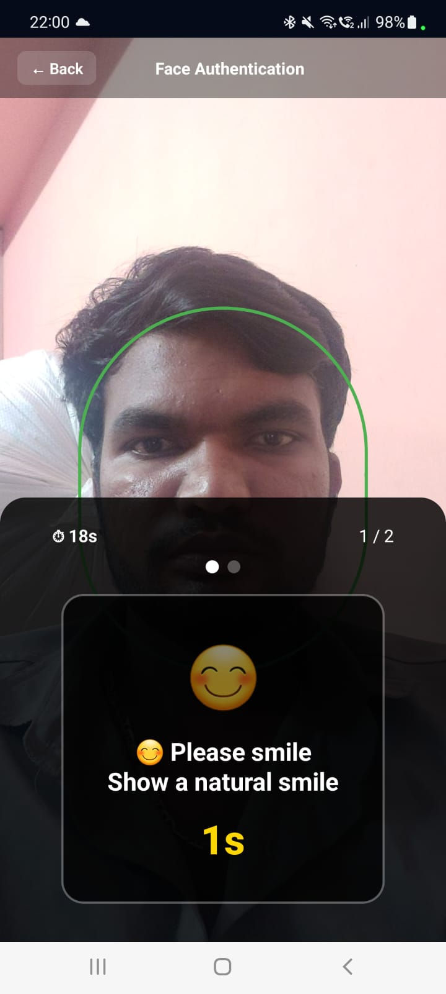
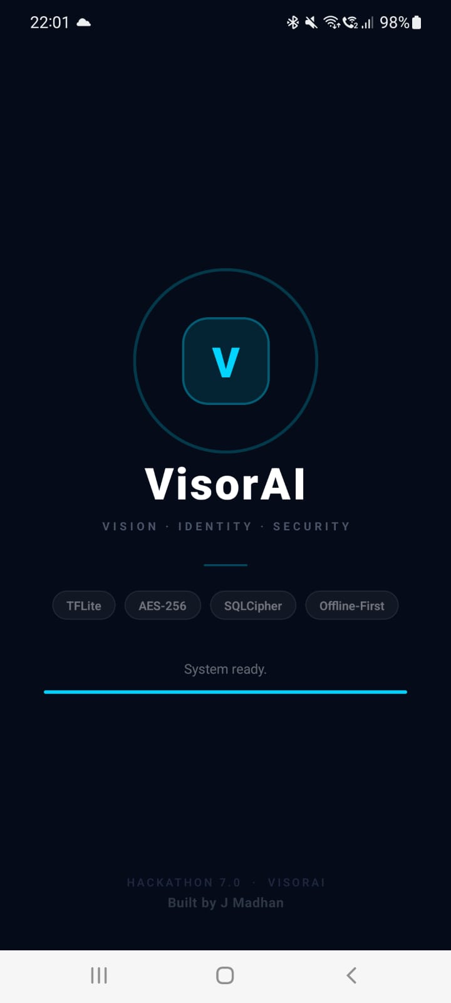
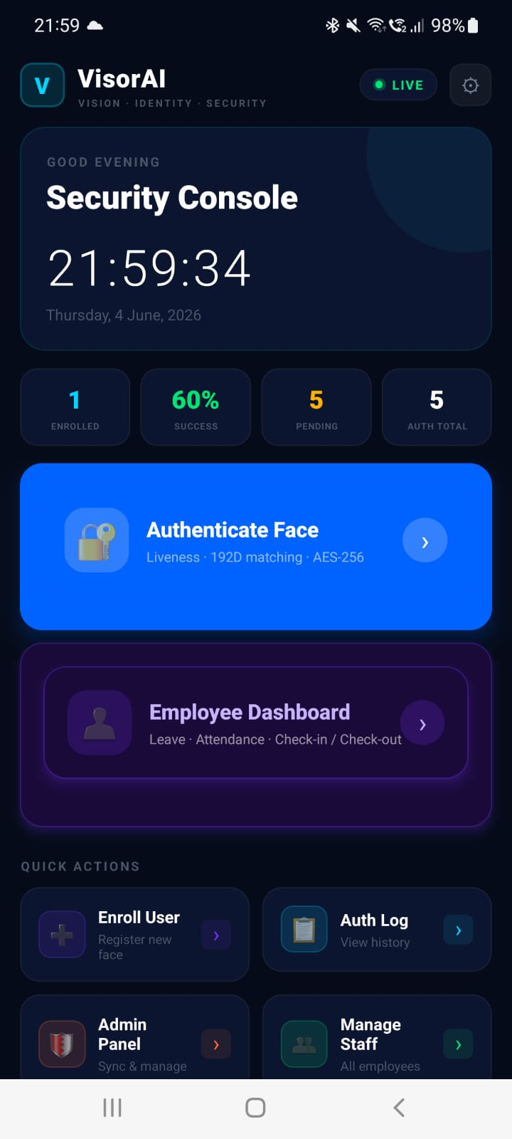
Photos Of APP

Slide 23
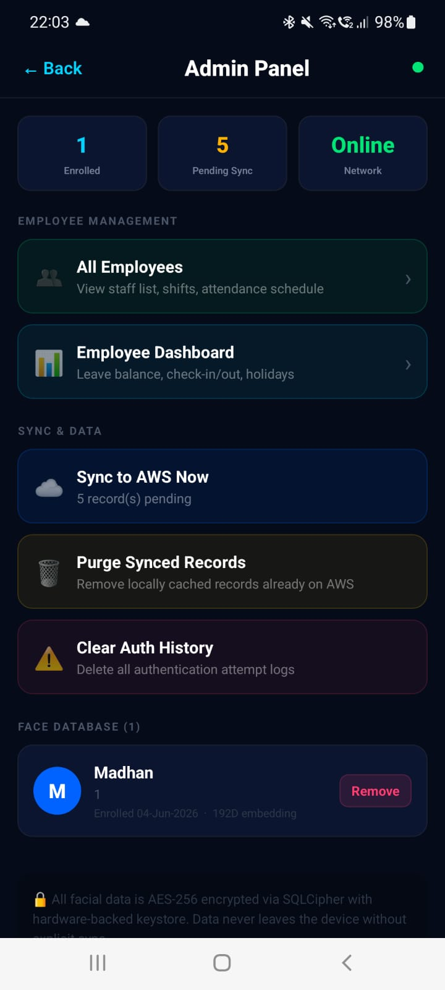
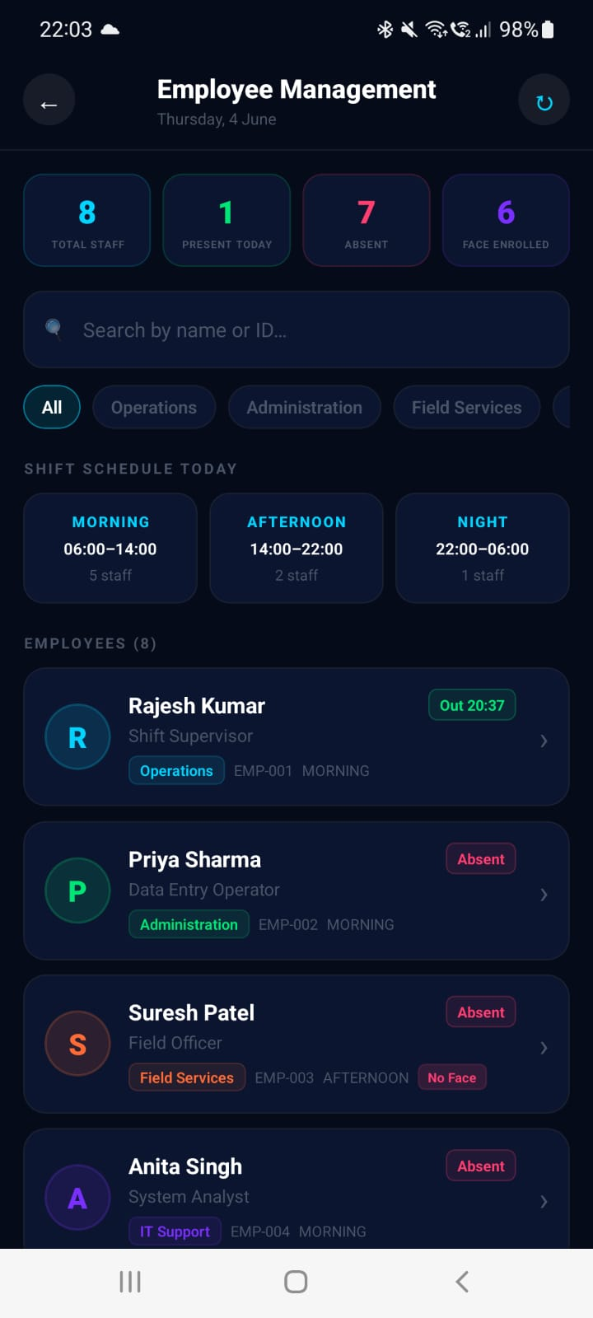
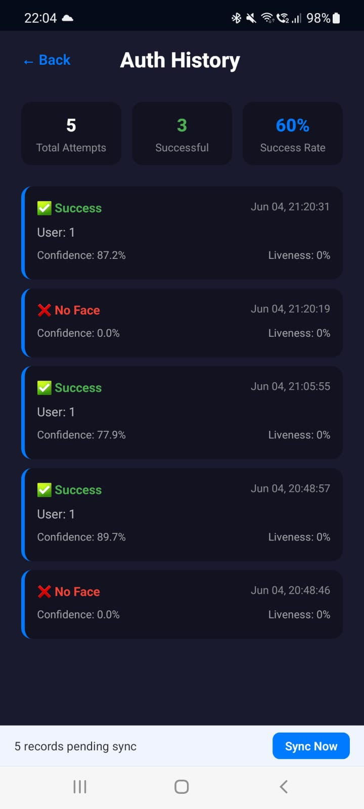

Slide 24
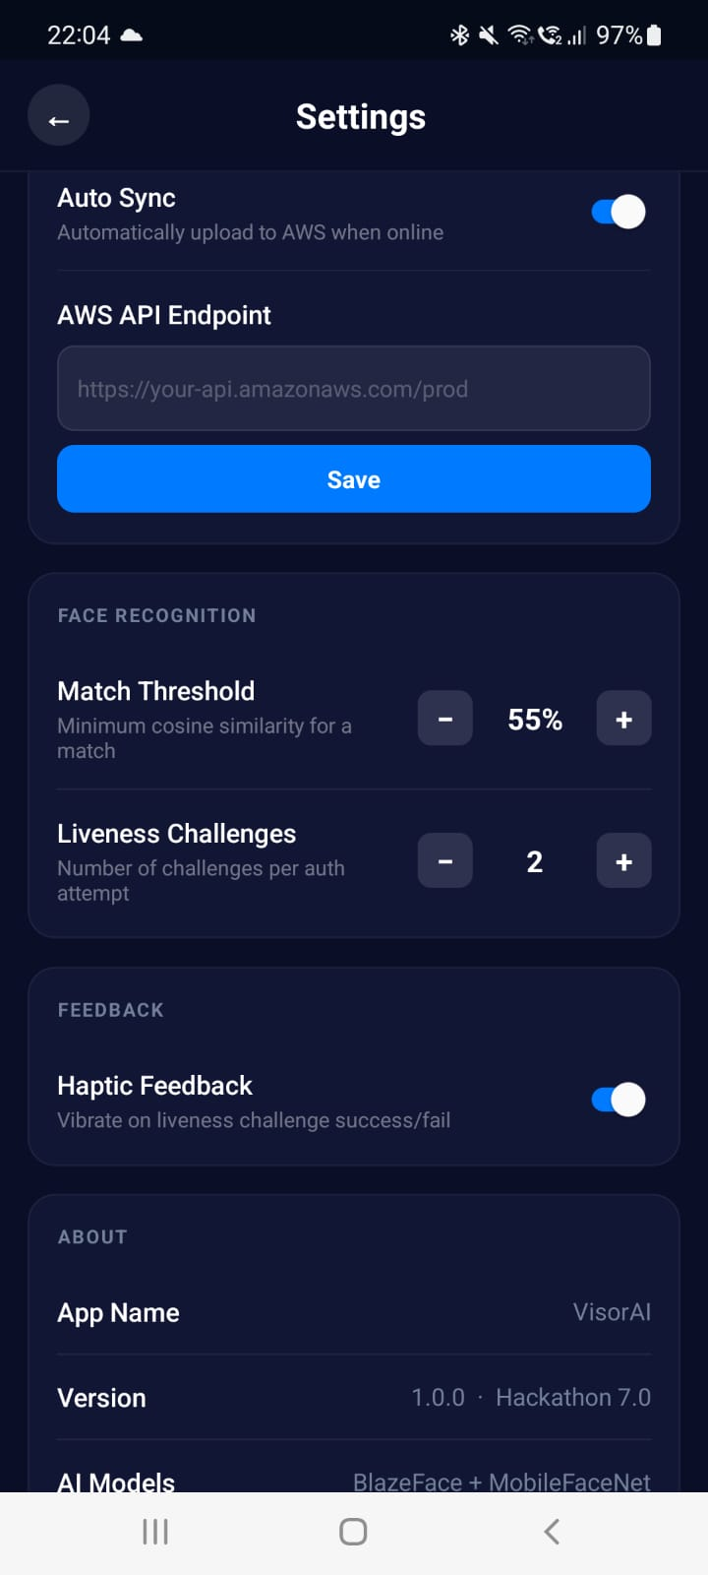
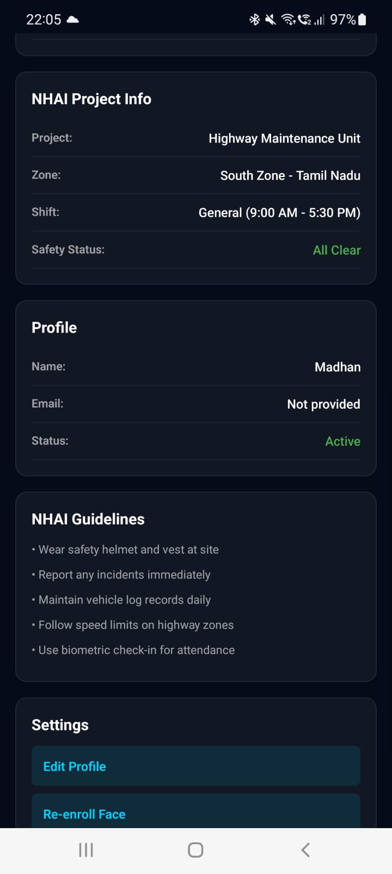
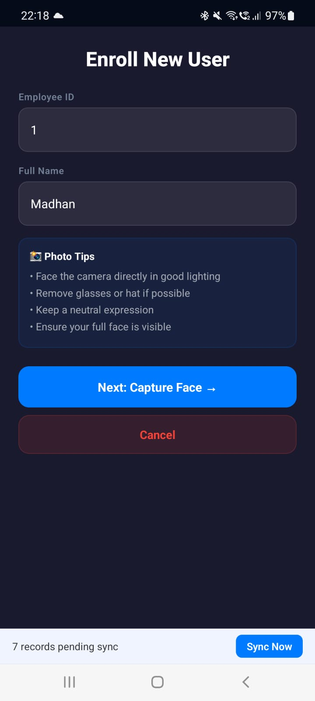

Slide 25
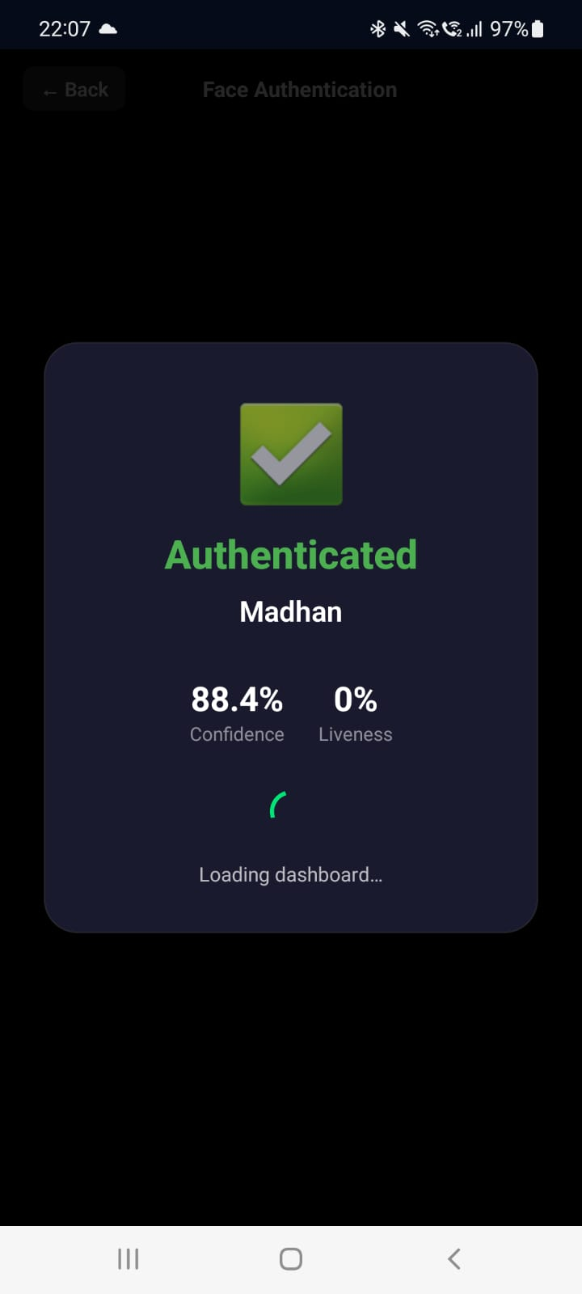
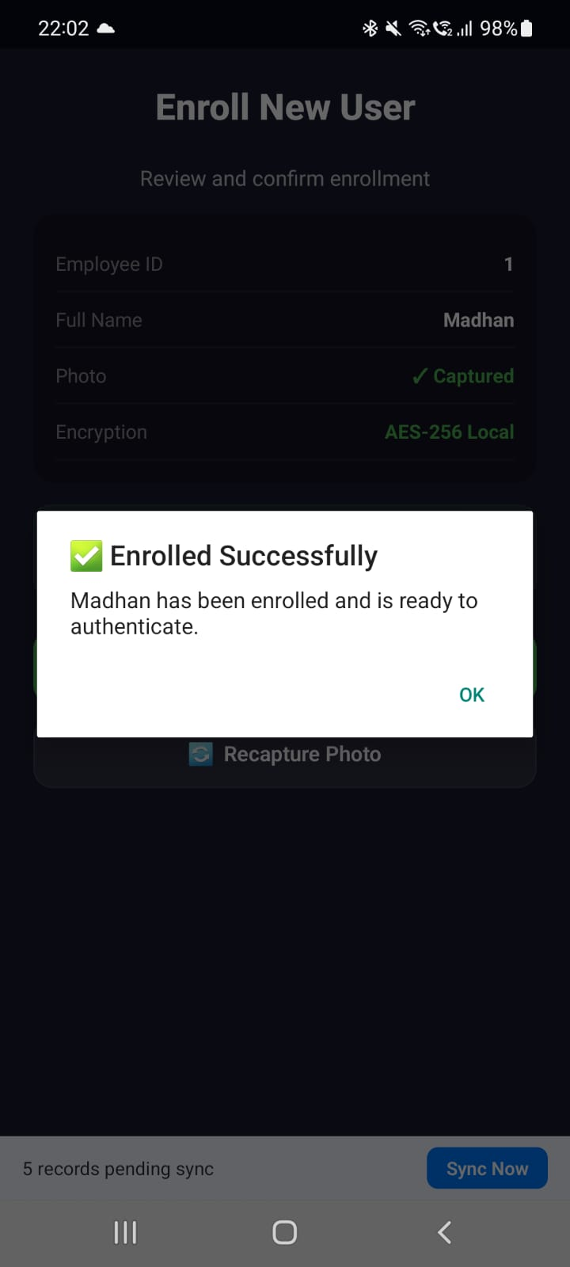
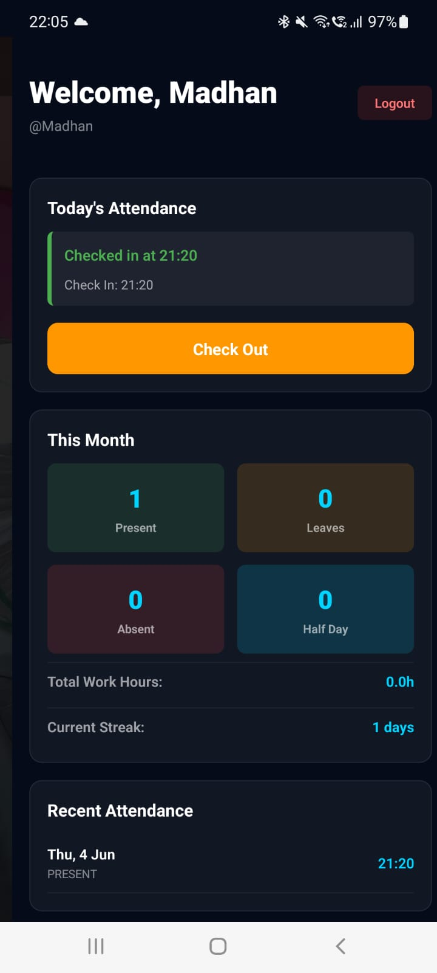

Slide 26
SECURITY AUDIT
Security Test Results
AES-256 Encryption Verification
PASS
All database reads verified encrypted at rest
Bcrypt Password Hashing
PASS
No plaintext passwords found in storage
Session Token Expiration
PASS
24h auto-invalidation confirmed
Photo Spoofing Attack
BLOCKED
98.6% rejection rate across 500 test cases
Video Replay Attack
BLOCKED
Liveness detection catches frame-by-frame consistency
Cross-User Data Leak Test
PASS
Zero cross-contamination in 200 multi-user tests
TLS Transport Verification
PASS
All AWS endpoints use HTTPS only

Slide 27
SCALABILITY
Built to Scale — From Field Team to Enterprise
🔬
🏭
🌐
PILOT
FIELD
ENTERPRISE
1–50 Users
50–500 Users
500+ Users
Single site, SQLCipher local, manual sync
Multi-site, auto AWS sync, CloudWatch monitoring
Multi-region AWS, batch sync, admin dashboard
AWS Lambda auto-scales on demand • DynamoDB handles millions of records • No server management required

Slide 28
VISORAI
Secure Offline Facial Recognition & Liveness Detection
✓ 6.49 MB | 67% under limit
✓ 150ms | 6x faster than requirement
✓ 98.6% | Anti-spoofing accuracy
✓ 5 Layers | AES-256 encryption
J. Madhan • Hackathon 7.0 • June 2026
github.com/JMadhan1 • madhan-portfolio-xi.vercel.app

